Slide 1
WACO, TEXAS
#AEP5
Notes:
AEP5 changes the conversation about the arts from “funding” to “investment in an industry” that provides both cultural and economic benefits.
Benefits of the arts go far beyond economic impact, of course. They inspire, delight, educate, and unite us. Art is a fundamental component of our humanity.
Arts are an industry—one that supports jobs, generates govt. revenue, and is a cornerstone to tourism.

Slide 2
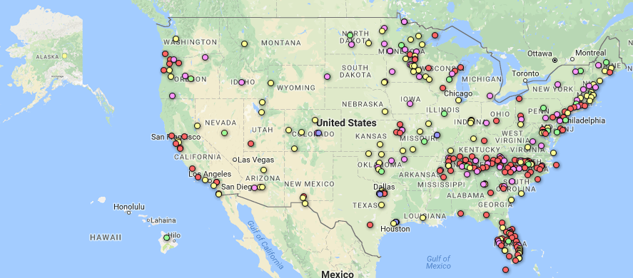
Most Comprehensive Study Ever!
341 Study Partners in all 50 States—Including Waco
Notes:
5th economic impact study of spending by nonprofit arts and cultural organizations and their audiences.
largest and most comprehensive ever conducted: 341 study regions in all 50 states + D.C., small rural to large urban, populations ranging from 1,500 to 4 million.
Only nonprofit and municipal arts and cultural organizations no for-profit entertainment businesses such as Broadway or the motion picture industry, and no individual artists (all vital to the cultural ecology, but beyond the scope of the study).
Why just nonprofits? Because government and philanthropic dollars are typically directed to these organizations. It is appropriate to ask, “Beyond quality of life, what is the ROI of that investment?”
Conservative and Reliable Methodology . . .
Only data included from organizations that provide it. No local estimates for non-respondents. (29 organizations were surveyed in Waco.)
Over-sample of audience interviews from a diverse range of events/venues (performing arts, museums, festivals). (1,164 surveyed.)
Georgia Tech economists customized an input/output model for all 341 study regions. (Input/output models have been the basis of 2 Nobel Prizes in Economics. The AEP methodology has been vetted by the White House Council of Economic Advisors and bank economists among others.)

Slide 3
AEP5 National Partners
Notes:
AEP5 National Partners are organizations of public and private sector leaders that steer billions of dollars in public and private sector arts funding and create arts-friendly policies. They are partners because, (1) they believe the arts are a fundamental component of a healthy community, and (2) they approve of the methodology and findings. Their logos are on the back cover of every AEP5 report. This boost your credibility when advocating with the data.
U.S. Conference of Mayors and National League of Cites are partners.
International City/County Management Association.
Conference Board and Committee encouraging Corporate Philanthropy.
Council on Foundations and Independent Sector.
Destinations International and National Alliance of community Economic Development Associations.
In a 2017 National League of Cities report about key issues facing city leaders, “Economic Development” tops the list at #1. Within economic development, “Arts and Culture” are listed among just five core subject areas along with jobs, business attraction, and downtown development. (“State of the Cities 2017”: http://www.nlc.org)
A 2017 AFTA Business Committee for the Arts Survey, conducted with the Conference Board, showed that 67 percent of businesses that support the arts do so because it improves the economy and quality of life. (http://www.americansforthearts.org/events/bca-10)

Slide 4
29 Arts & Cultural Non-Profits in Waco
Art Center Of Waco ∙ Baylor University School of Music ∙ Baylor University, Department of Theatre Arts ∙ Cameron Park Zoological & Botanical Society ∙ Central Texas Artist Collective ∙ Central Texas Choral Society ∙ City of Waco Parks and Recreation Special Events ∙ Creative Waco ∙ Dr Pepper Museum & Free Enterprise Institute ∙ Heart O'Texas Fair & Rodeo ∙ Historic Waco Foundation ∙ Kwbu-Fm/Brazos Valley Public Broadcasting Foundation ∙ Martin Museum of Art, Baylor University ∙ Mayborn Museum Complex ∙ McLennan Community College Performing & Visual Arts ∙ Mission Waco Mission World Jubilee Theatre ∙ Out On A Limb Dance Company ∙ Restoration Haven’s Miriam’s Army Dance ∙ Texas Ranger Hall of Fame and Museum ∙ Greater Waco Chamber of Commerce Events ∙ Waco Children's Theatre ∙ Waco Civic Theatre ∙ Waco Community Band ∙ Waco Cultural Arts Fest dba Cultural Arts of Waco ∙ Waco Hippodrome Performances ∙ Waco Mammoth National Monument ∙ Waco Poets Society ∙ Waco Symphony Association ∙ Youth Chorus Of Central Texas.
Notes:
Waco participants: One of highest participation rates in entire nation.
We could not have done this without everyone’s help!

Slide 5
What do these numbers tell us?
Expenditure of non-profit arts & cultural organizations (2015). 29 organizations completed “organizational survey”
What people at venues and events wrote (2016) 1,164 surveys
Economic impact of non-profit arts & cultural sector – nationally & locally
How our community compares to others
What we do really well and where key opportunities are
Notes:
Method: Organizational surveys & randomized audience intercept surveys

Slide 6
National Impact, $166.3 billion (2015)
Notes:
Total economic activity for all the USA partners. Composed of two figures—spending by nonprofit arts and cultural organizations and the event-related spending by their audiences
note the Audience impact excludes ticket/entry purchase, as that’s counted in the Organization portion…so it’s not double-counted).
This is a myth buster. Sure, we appreciate the beauty of the arts, but most folks don’t realize that these are businesses. They employ people locally, purchase goods and services within the community, are members of the Chamber of Commerce, and involved in the marketing and promotion of their regions. Arts organizations are good business citizens.

Slide 7
Waco, $63.7 million
Organizations
$31.4 million
Audiences
$32.3 million
Notes:
Waco punches above its weight, delivering TWICE the economic impact compared with other cities its size.
…but notice the difference between national and local picture. In Waco, Audiences account for under 50% of the overall impact…increasing audience spending would make impact even greater.

Slide 8
Jobs Supported (FTE)
2,184
Notes:
Not just food for the soul – food on the table
Arts organizations employ more than just artists, curators, and musicians. They also pay builders, plumbers, accountants, printers, and occupations spanning many industries.
Remember that our economic analysis measures jobs supported throughout the community, not just AT arts organizations.
Because arts organizations are strongly rooted in their community, these are jobs that necessarily remain local and cannot be shipped overseas. (Even in a global economy, arts remain local employers)

Slide 9
State & Local Government Revenue
$7.4 million
Notes:
Local and State Government receives $7.4m in revenue every year as a result of the economic activity of our nonprofit arts& cultural organizations and their audiences.
Currently there are threats against nonprofits because of the mistaken assumption that they only take, but don’t give back. This study shows that beyond their public benefit, there is also a significant economic return as a result of their investment. Arts funding to nonprofits is not a one-way street.

Slide 10
Attendees in Waco Spent
$24.74 Per Person, Per Event
Notes:
LIKE all industries, spending by arts organizations has a measurable economic impact. UNLIKE most industries, the arts generate a bounty of event-related spending for local businesses—dollars that land in the pockets of local business establishments such as parking garages, restaurants, retail stores, hotels, and even the local babysitters.

Slide 11
Waco Audiences: Local vs. Non-Local
51.5 % of visitors indicated that the primary purpose of their visit to the City of Waco was “specifically to attend this arts/cultural event.”
Notes:
In addition to spending information, those surveyed also provided their zip code so we could determine whether they live IN the county in which the arts event takes place (local) or outside the county (non-local).
Nationally, 34 percent of arts attendees come from outside of the county that they live in (up from 32 percent in 2010).
Does their spending differ from local attendees . . .?

Slide 12
USA Event-Related Spending
Local vs. Non-Local
44.5 percent of local attendees would have “traveled to a different community to attend a similar cultural event.”
Notes:
We asked local attendees about what they would have done if the arts event that they were attending was not taking place: 44% said they would have “traveled to a different community to attend a similar arts event.”

Slide 13
spending on meals
Local vs. Non-Local
Notes:
This is the biggest area of difference between Waco figures and national figures. It’s for expenditure on meals/drinks before or after a performance or event.
Why? Perhaps lower cost of living…but more likely because there are limited opportunities to eat out in or near our arts/cultural venues (Waco Hall, MCC, Civic Theatre, etc.)

Slide 14
20% of the non-local visitors had stayed overnight. Their average spend (excluding tickets)
$145.96
Notes:
When visitors become “heads in beds”, the average spend triples.

Slide 15
Participation by Income
Notes:
Waco involves all socio-economic groups much more evenly than many communities. This is a success story, meaning our arts events are winning audiences of all kinds.

Slide 16
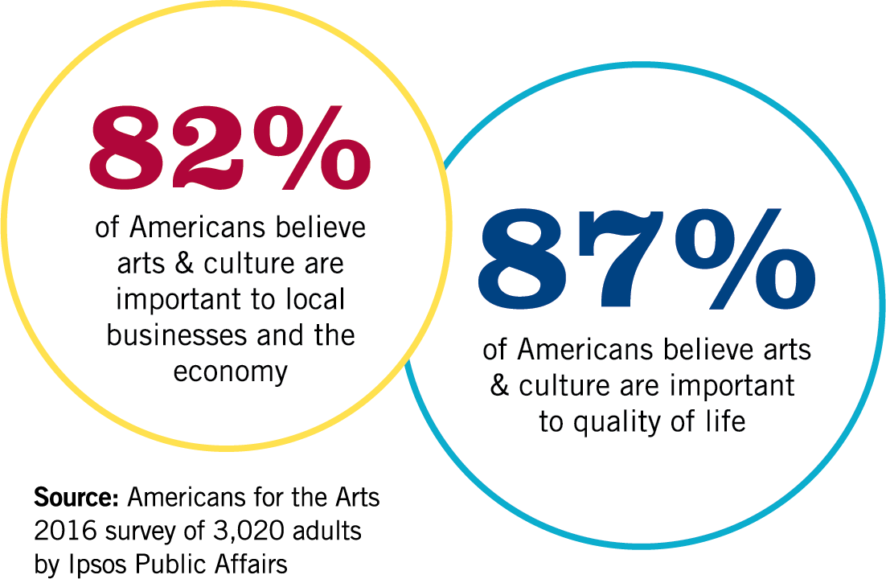
Americans Value Arts & Culture
Notes:
Not surprising that people understand the impact on quality of life,
It’s good news that local economic impact is also being more widely understood.

Slide 17
All U.S. Arts Industries (2014)
$730 Billion = 4.2 Percent of GDP
Source: U.S. Bureau of Economic Analysis
Notes:
Adding more gravitas to the economic impact of the arts argument . . . the U.S. Bureau of Economic Analysis (BEA) established the Arts & Cultural Production Satellite Account, which takes into account the full breadth of the nation’s art and culture industries. That is, not just the nonprofit sector (like AEP5), but also the commercial and entertainment sectors, individual artists, Broadway, motion picture industry, architecture and design, university education programs, etc.
According to BEA, the arts were a $730 billion industry in 2014, which represents 4.2 percent of the nation’s Gross Domestic Product—a larger share of the economy than transportation, tourism, agriculture, and construction.
It’s important to realize that the larger industry is dependent on the non-profit arts & cultural sector as the laboratory for creativity and platform for talent.

Slide 18
We Make the Difference!
Get your AEP5 numbers and tools at www.ArtsUSA.org/AEP5
Tell your arts story again and again . . . Do one of these per month!
  Chamber of Commerce Arts Breakfast
  Rotary Club Lunch
  Editorial Board meeting
  City/County Council work session
  Arts funders lunch
  Email your Members of Congress TODAY!
Join the ArtsActionFund.org. It’s free!
Notes:
What do you do with a $166.3 industry that supports 4.6 million jobs and generates $27.5 billion in government revenue? Invest in it, nurture it, and grow it!"

Slide 19
Arts + Culture
Means Business!
AmericansForTheArts.org/AEP5

